Slide 1
IMM 120 / CSC 101
Welcome!

Slide 2
Today
Learn about the class.
Talk about learning how to program.
Make a terrible sandwich.
Draw a house with code.

Slide 3
My Name is Chris Hallberg
crhallberg@gmail.com
Office: To the right of the IMM office
Office Hours: 11am until class every Monday, online too!

Slide 4
About the Class
There is no textbook for the class
Make: Getting Started with p5.js
by Lauren McCarthy (creator of p5.js)
JavaScript: The Good Parts
by Douglas Crockford
The Nature of Code
by Daniel Shiffman (online)

Slide 5
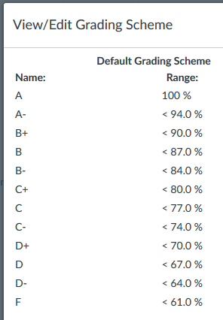
About the Class
Your final grade will consist of:
20% for attendance
20% of all Homework
25% for your midterm project
35% for your final project

Slide 6
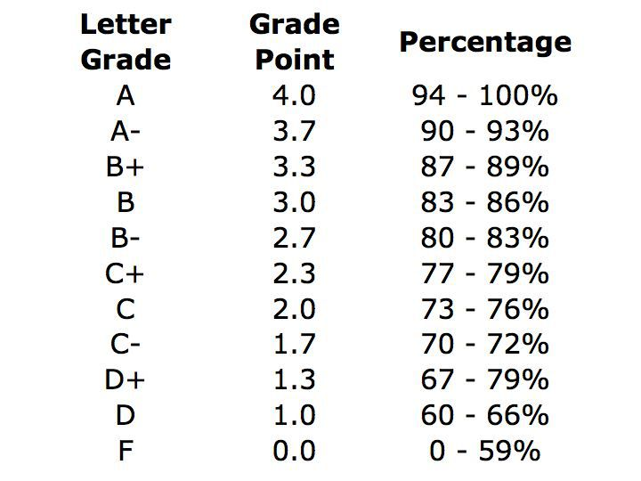
About the Class
Your final grade will consist of * :
15% for attendance
25% of all Homework
25% for your midterm project
35% for your final project

Slide 7
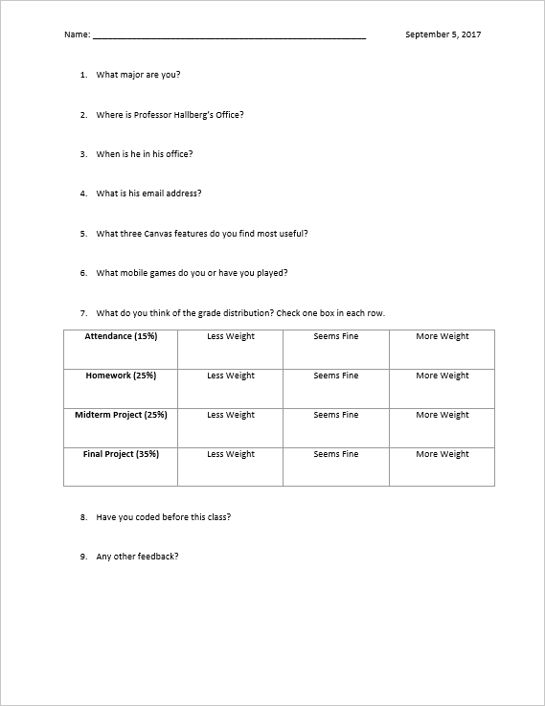
Minute Surveys

Slide 8
Learning to Program
"All programmers are playwrights and all computers are terrible actors.“
~ Anonymous

Slide 9
What it’s like to learn to program
Like learning a foreign language
Like learning a new way to think (algorithmically)
Learning a formal way of breaking down problems into steps

Slide 10
Programming is a Skill
It can be learned and it can be difficult
Notes:
“difficult” -

Slide 11
For example: Doors
Can the player open them?
Can the player open every door in the game? Or are some doors for decoration? How does the player know the difference? Can doors be locked and unlocked?
What tells a player a door is locked and will open, as opposed to a door that they will never open?
Does a player know how to unlock a door? Do they need a key? To hack a console? To solve a puzzle? To wait until a story moment passes?
Where do enemies come from? Do they run in from doors? Do those doors lock afterwards? Are there doors that can open but the player can never enter them?
How does the player open a door? Do they just walk up to it and it slides open? Does it swing open? Does the player have to press a button to open it? Do doors lock behind the player?
What size is a door? Does it have to be big enough for a player to get through?
What about co-op players? What if player 1 is standing in the doorway – does that block player 2?
What about allies following you? How many of them need to get through the door without getting stuck?
What about large enemies? Do enemies that are larger than a person also need to fit through the door?

Slide 12
For example: Sandwiches
This is going to be silly
Does anyone have a peanut allergy?

Slide 13
p5.js
How we’re going to learn how to program

Slide 14
https://editor.p5js.org
Where we’re going to learn how to program

Slide 15
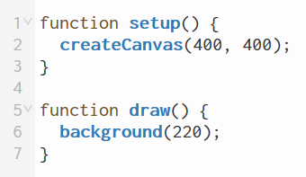

Slide 16
Coordinates and Axes

Slide 17
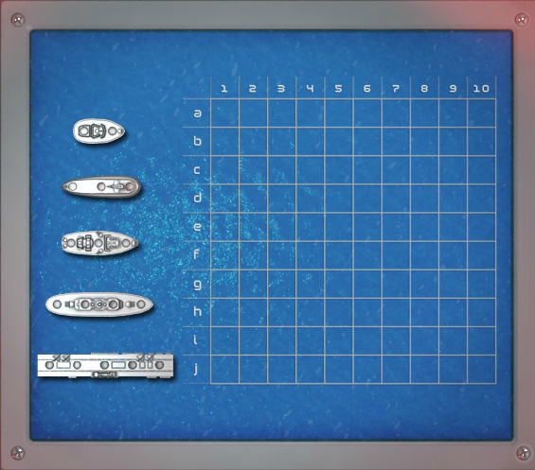

Slide 18
horizontal / x-axis

Slide 19
vertical / y-axis

Slide 20
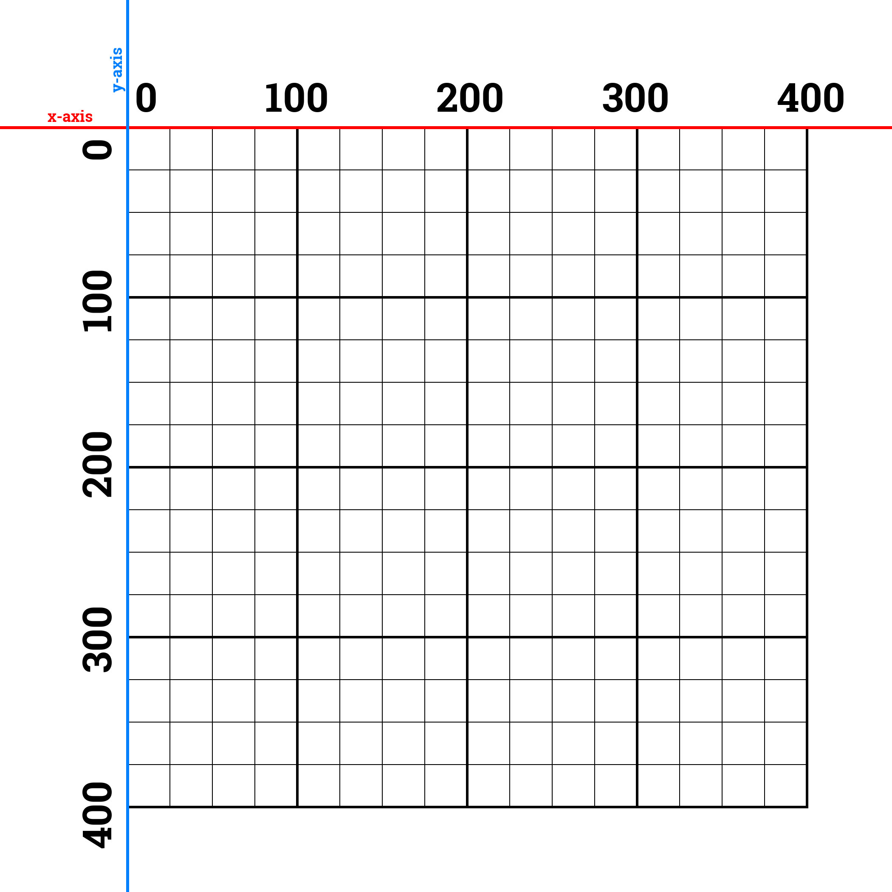

Slide 21
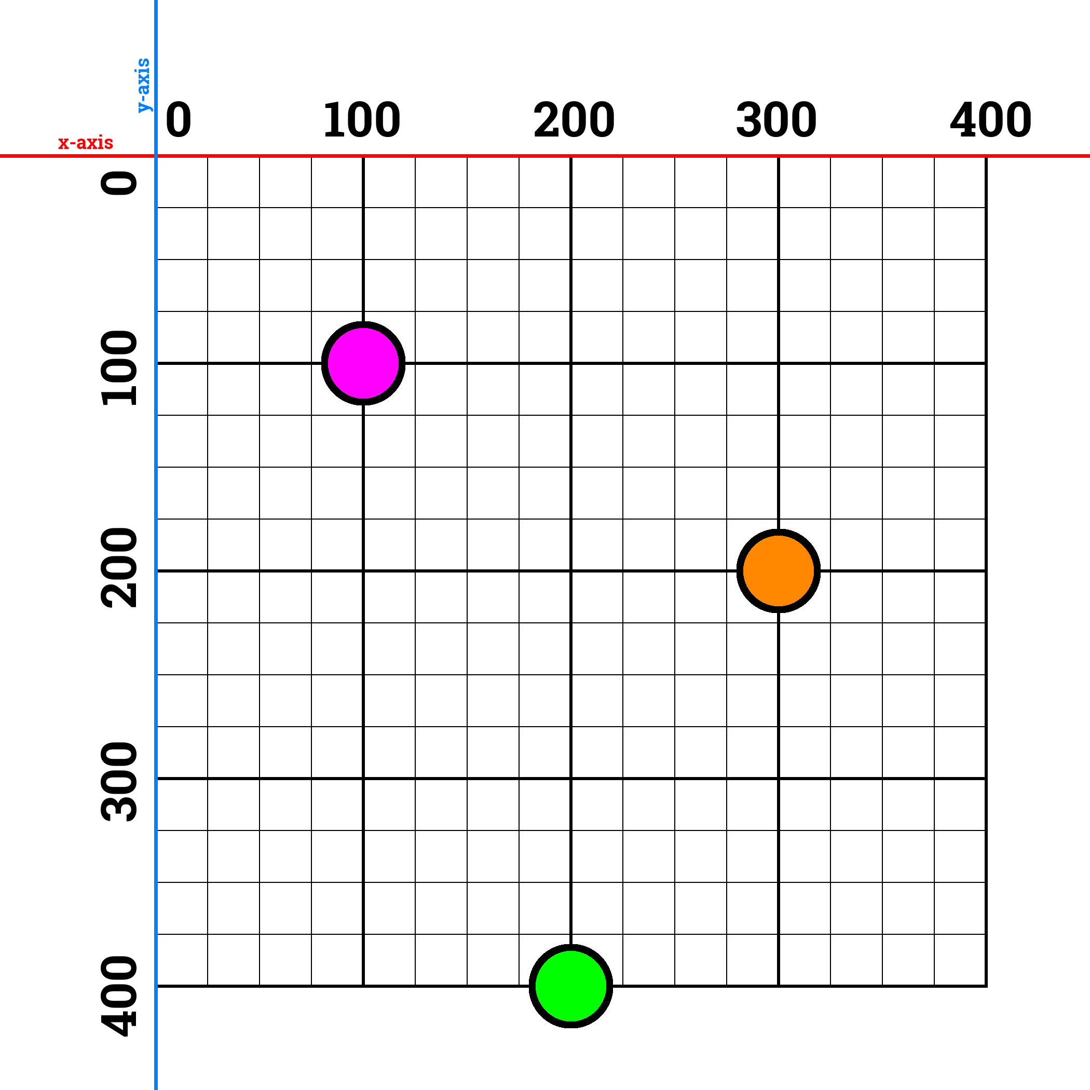

Slide 22
Making A House

Slide 23
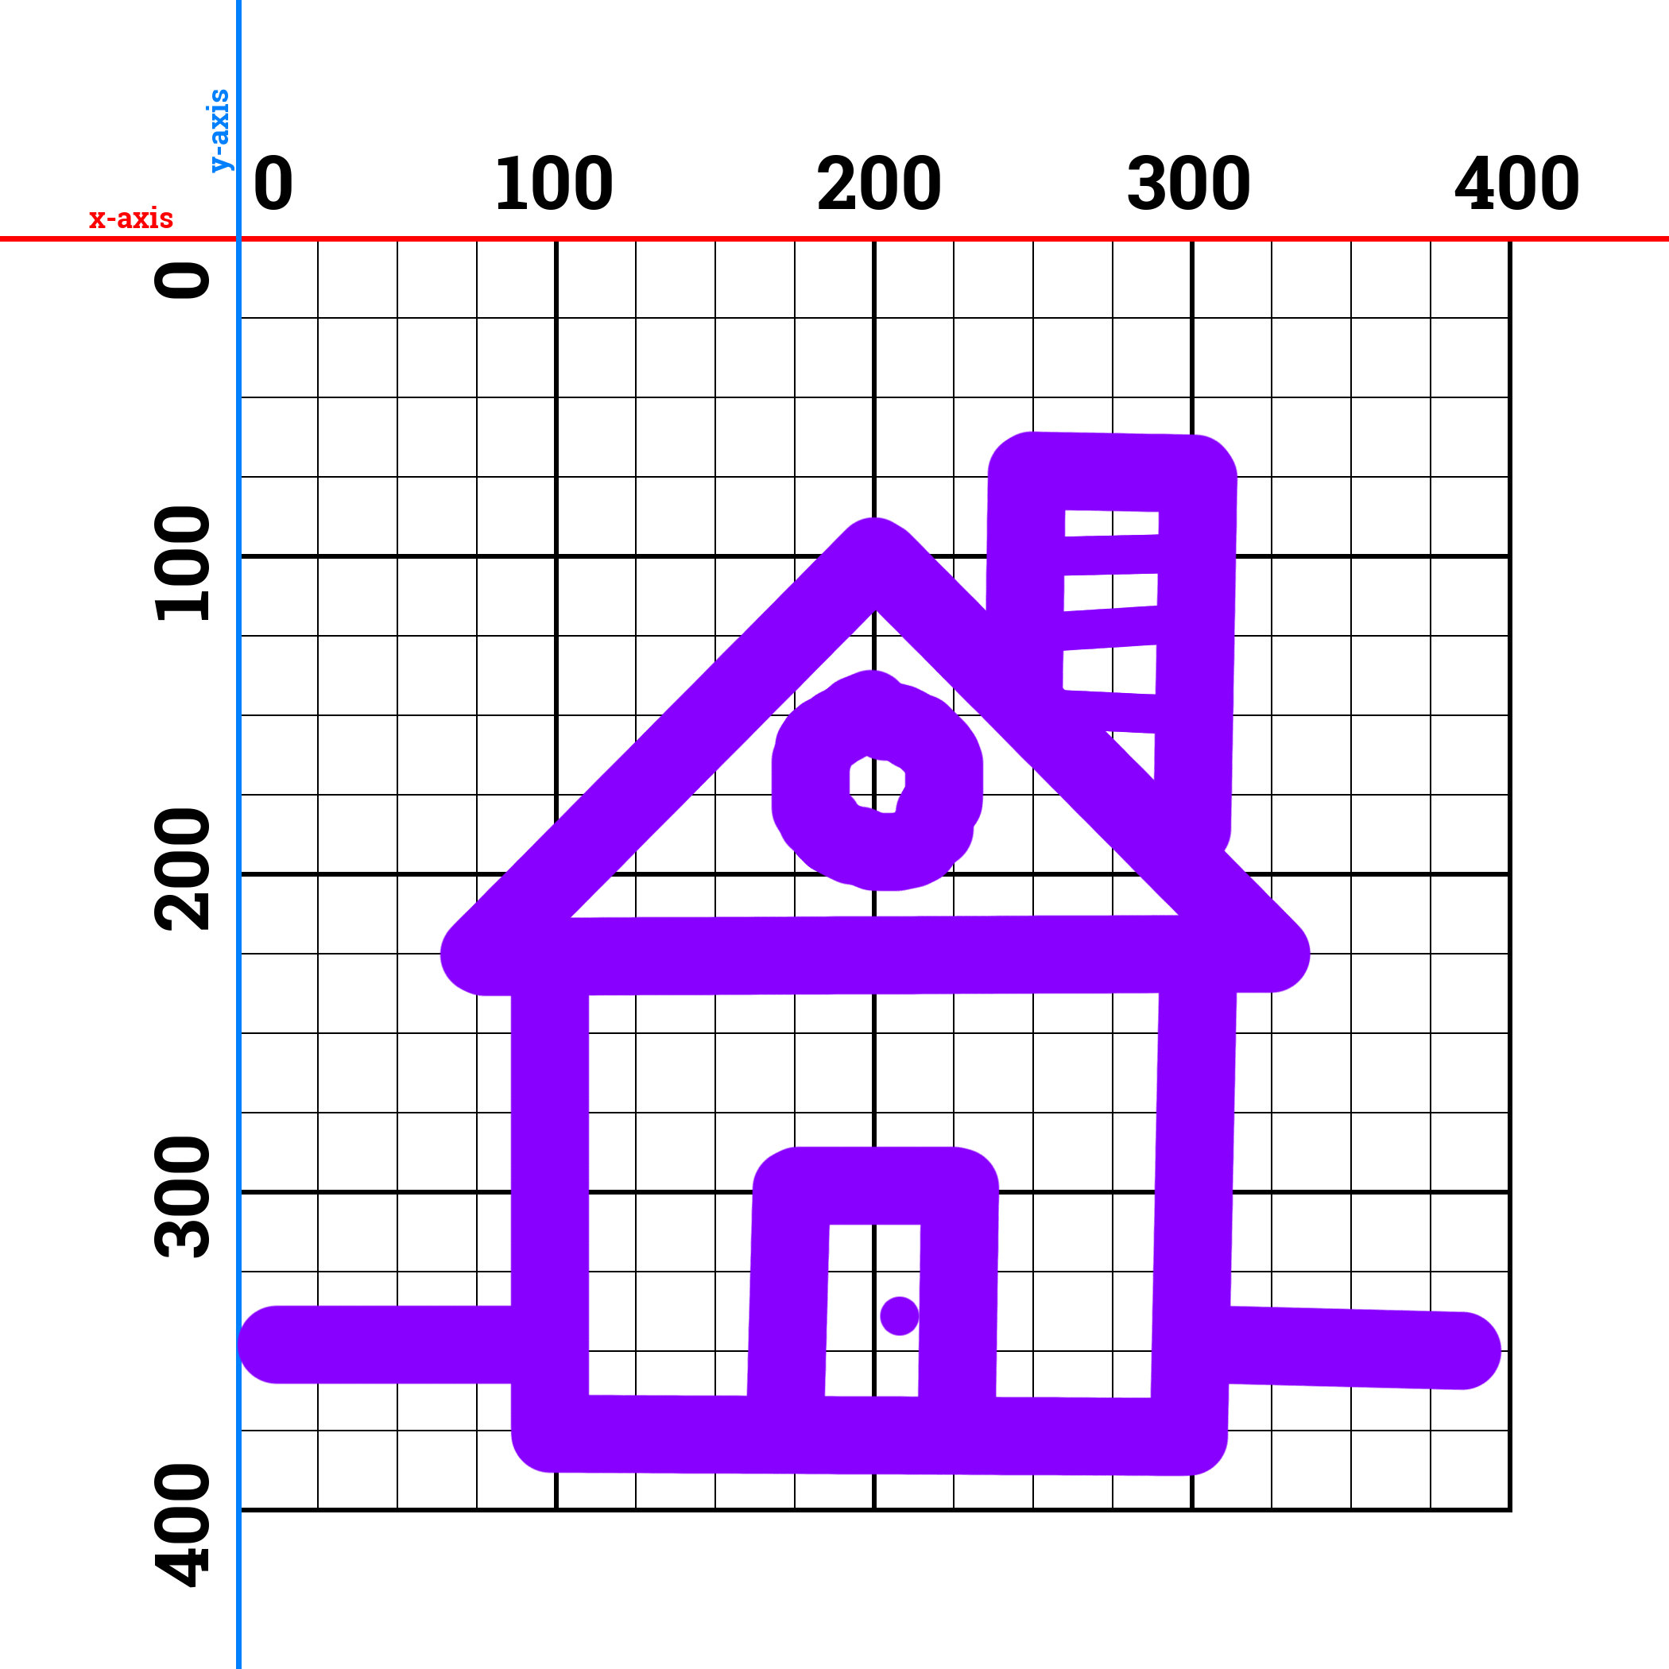

Slide 24
line
x2, y2
x1, y1

Slide 25
ellipse
x, y

Slide 26
rectangle
x, y

Slide 27
triangle
x2, y2
x1, y1
x3, y3

Slide 28
line – 100, 200, 50, 100
line(100, 200, 50, 100);

Slide 29
Shape Commands
line (x1, y1, x2, y2);
ellipse (center x, center y, width, [height]);
rect (corner x, corner y, width, height);
triangle (x1, y1, x2, y2, x3, y3);

Slide 30
Colors

Slide 31



Slide 32
Red-Green-Blue
Just like coordinates are always in pairs, these go in triple.
Values go from 0 to 255. (it’s a binary thing)
If you only put one, p5.js will put that number in all three.
Use a color picker.
background(100) == background(100, 100, 100)

Slide 33
Color Commands
fill – inside color of the following shapes
stroke - line color of the following shapes
background – clear the entire screen w/ one color

Slide 35
Homework
Take your house and email me the link and the exported zip of your project.
crhallberg@gmail.com

Slide 36
Minute Surveys
Once you hand in your survey, you may go.
If you have questions or concerns, I will stay and answer them for as long as I can.

